Slide 1
Network planning and simulation with Atoll and e ENSp.
Problem description
The problem given where
Construction(simulation) a WLAN for FET building with ENSp
Using Atoll and Gooogle Earth implement a Radio frequency planning of the town Buea.

Slide 2
WLAN FOR THE FET BUILDING
The objective here is to minimize the resources we have in constructing a 1 AC(access Controller ) with more than 2 APs(Access points).
Utilizing concepts like DHCP WLAN, CAPWAP, TRUNK, VLAN, PVID, IP addresses, SSID, and more in the implementation.
Proposed Solution.
Our system is Wlan with over 1 AC , 5 Aggregation switches, 4 APs, and over 8 end devices . We proposed a maximum of one AP per floor for the three floors and the 4th AP for the building external coverage to enable you utilize the network a few meters from the building.

Slide 3
PROCEDUE
Logical and Physical Topology
Logical
Our system makes use of 2 DHCP Servers
AC
It is the DHCP server for the APs its responsible for dynamically allocating ip address to the Aps interspaces in the network.
it uses the ip address trunk of 192.168.100.254 / 24 and network address of 192.168.100.0 mask 24.
S1
It is the DHCP server for the STAs its responsible for dynamically allocating ip address to the APs interspaces in the network.
It uses the ip address trunk of 192.168.101.254 / 24 and network address of 192.168.101.0 mask 24.

Slide 4

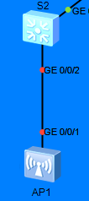
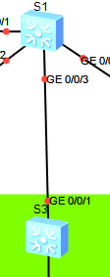
Part Diagrammatic Representation
KEY FUTURES
VLAN 100 101: The command vlan batch 100 101 was used to create vlan batch 100(for APs) and batch 101(for STAs).
TRUNK: the command port link-type trunk was used to trunk the IPs addresses.
The command port trunk allow-pass vlan 100 101, was used to allow the passage of both vlan 100 IPs and vlan 101 IPs.
PVID : The pvid was used to untag signals from the STAs by applying the command port trunk pvid vlan 100.

Slide 5
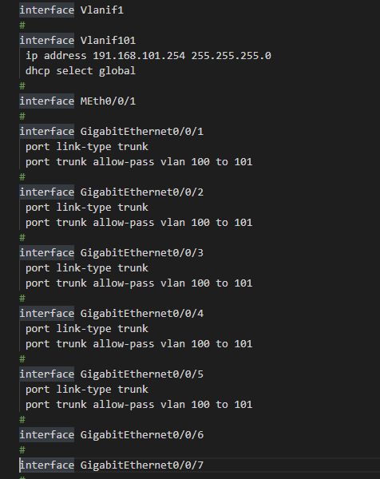
S1 Configurations
KEY FUTURES
DHCP : we enable dhcp to permit S1 and AC to dynamically allocate IP addresses to each device. By use the command dhcp enable.
Vlanif : To make sure the AC or S1 dhcp severs allocate to the right device we use the command int vlanif 100 for AC ip add 192.168.100.245 24. followed by dhcp select global.
Ap pool : we need to crate an ap pool so as to allocate Ips to the devices.

Slide 6
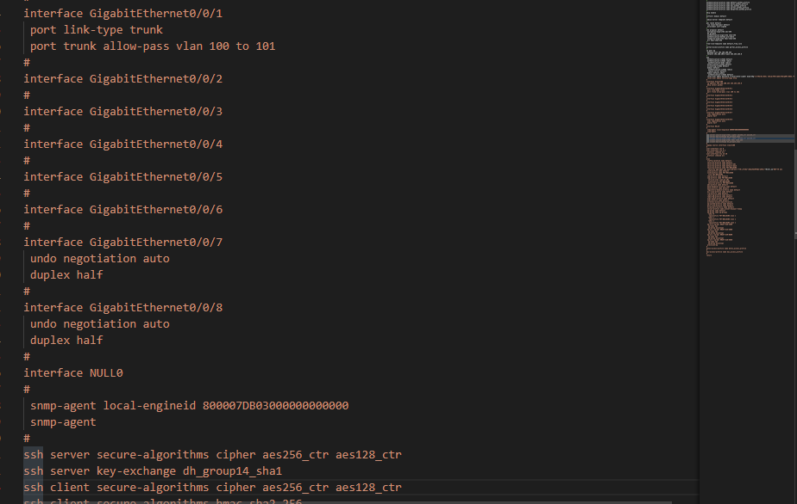
AC Configurations
KEY FUTURES
WLAN: we need to do the rest of configuration in the wlan-view in the AC we type wlan.
AP GROUP: ap-group is is needed to bind the APs to the configuration, we use the command ap-group name ap-group1.
REGULATORY DOMAIN PROFILE AND COUNTRY CODE: we set the regulatory domain profile name to default and set the country code to CN so as to import the country network operation rules.

Slide 7
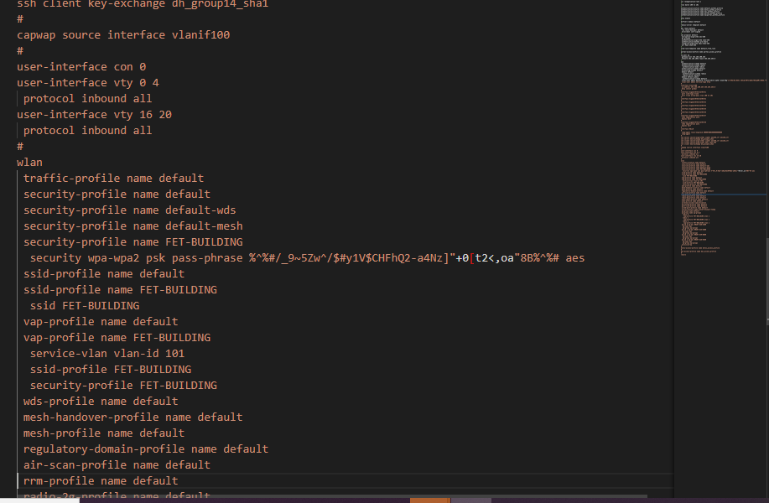
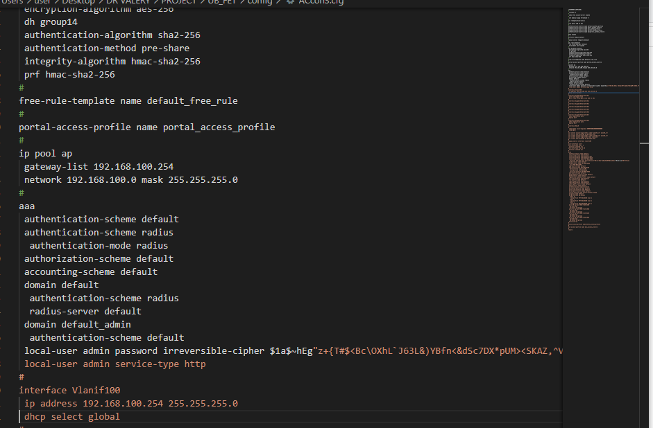
AC Configurations
From now we are free to ADD the APs and bind them to the AP group create. Giving the ap-id , before that we have to specify the authentication mode to aut-mac with the command.
We set up the capwap and set the source to vlan 100.
We set the SSID (FET-BUILDING) to authenticate each STA into the network. We no specify the the wap profile and bind to the ap-group1.

Slide 8
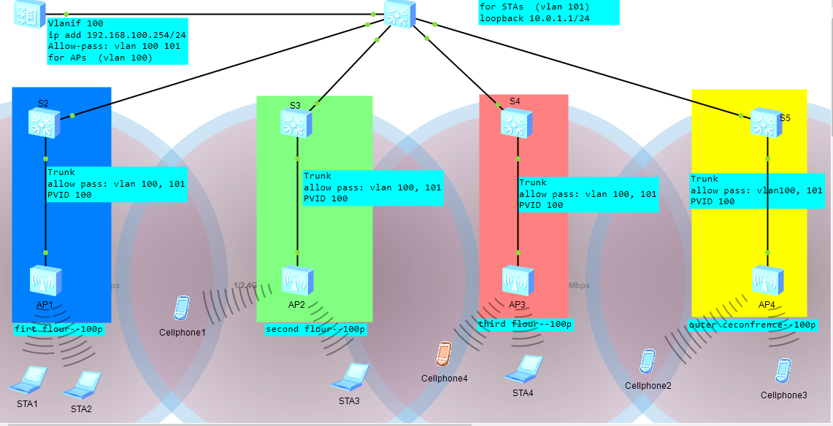
IMAGE SHOWING OUTPUT/Physical

Slide 9
LTE RADIO FREQUENCY PLANING OF BUEA
The objective here is utilize basic and complex networking tools (Forcks Atoll and Google Earth) based on population density of the Buea cross section area, to simulate(plan) 4G radio frequency network , in other to eliminate poor cost management and achieve better coverage with the right amount of resources.
Proposed Solution.
Based on the area of Buea and the population n density we deploy a set based station with three transmitters per station (120 degree sectoring ).

Slide 10
Procedure/statistics
The implementation of this project is in four stages.
Planning frequency
choosing the right bandwidth for a given frequency range .
Coverage planning giving our bandwidth we needed to distribute a defined cross sectional area (Buea) as on Google Earth. We use pins to pinpoint the BST location taking into consideration the population density .
Generating coordinates to be transmitted to Atoll. By use of the website: https://mygeodata.cloud/result.
Generating the site (Atoll ) and exporting to Google Earth.

Slide 11
LTE RADIO FREQUENCY PLANING OF BUEA
Number of BST = 28
Number of sectors per BST = 3
Number of Transmitters = 28*3
Cross sectional area = (870) sql m (2,850 ft)
Distance between each BST =
Population = 300,000p
Average user density =((870)^2)/300000
Coverage distance per transmitter = 25m
If we look at the number of BST to the area we see that theoretically have 756,900/28 = 27,032.14 mean in area of 756,900m sql each BTS should cover 27,o32m sql area.

Slide 12
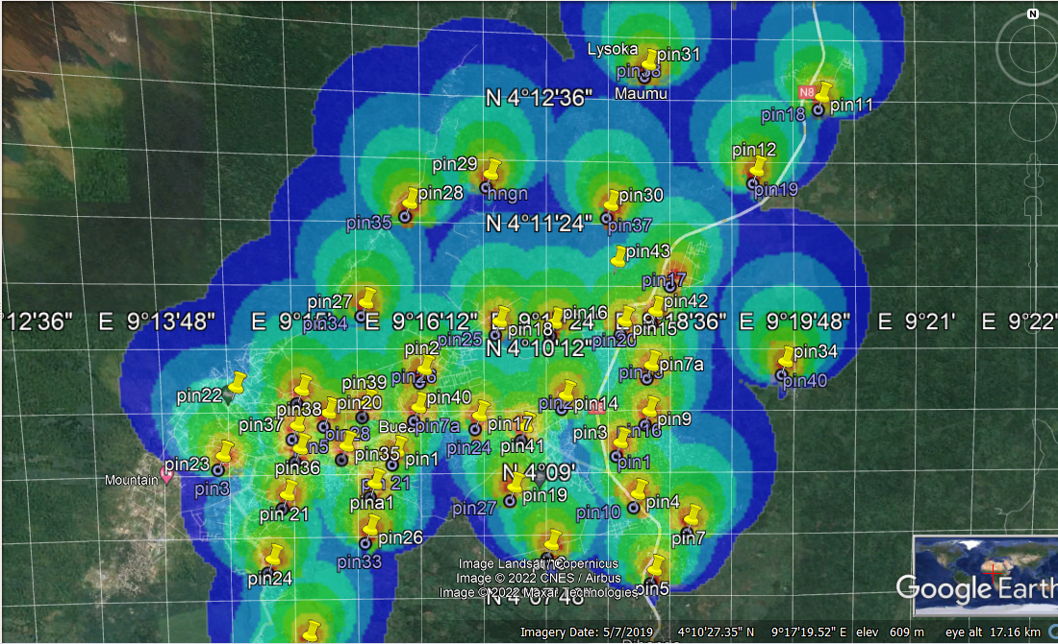
Images/output

Slide 13
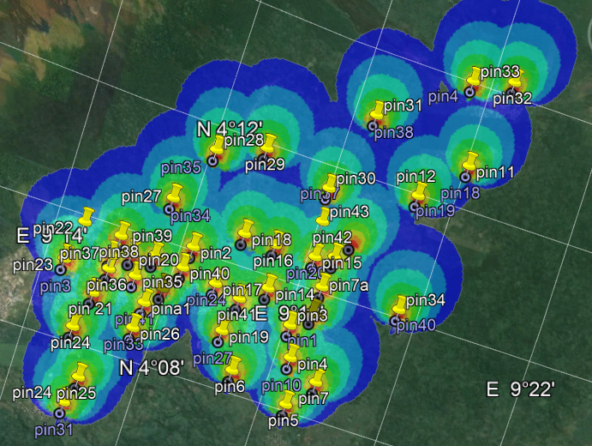
Images/output

Slide 14
Conclusions
In all we can say it was an interesting experience

